Slide 1

Introducing NextJS and TailwindCSS

Slide 2
Objectives
Describe about Next.JS
What is Next.JS?
Installation, Config and Run Next.JS
Describe about tailwind CSS
What is tailwind CSS?
Installation, Config and Run tailwind CSS

Slide 3
What is Next.js?
Open-source web development framework, which enables web applications with server-side rendering and generating static websites.
Next.js was released by Vercel (formerly known as Zeit) in 2016.
In 2019, Google began contributing to the project.
Next.js is often credited with completing React by offering the following features:
Server-Side Rendering
Static Site Generation
Image Optimization
Built-in Routing
Notes:
Today, many large websites such as Walmart, Apple, Nike, Netflix, TikTok, Uber, Lyft, and Starbucks use the framework.

Slide 4
History and Features of Next.js
History of Next.js: https://en.wikipedia.org/wiki/Next.js
Features of Next.js:
One of the main advantages of Next.js is its ability to handle server-side rendering out of the box, which perfectly supplements React.
This means that your application can be rendered on the server before being sent to the client, which can result in faster initial page load times and better search engine optimization (SEO).

Slide 5
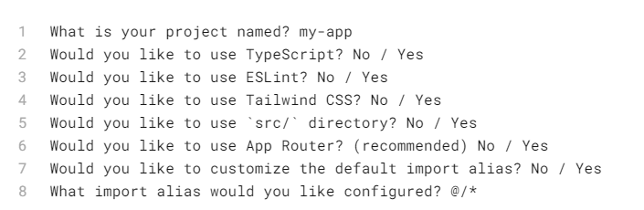
Installation Next.js
Automatic Installation or Manual Installation
We recommend starting a new Next.js app using create-next-app:
npx create-next-app@13.5.1
Rename Project
https://nextjs.org/docs/getting-started/installation

Slide 6
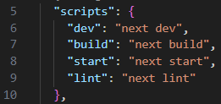
package.json
These scripts refer to the different stages of developing an application:
dev: runs next dev to start Next.js in development mode.
build: runs next build to build the application for production usage.
start: runs next start to start a Next.js production server.
lint: runs next lint to set up Next.js' built-in ESLint configuration.

Slide 7
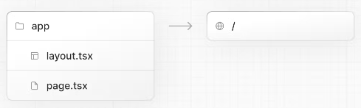
Creating directories
Next.js uses file-system routing, which means the routes in your application are determined by how you structure your files.

Slide 8

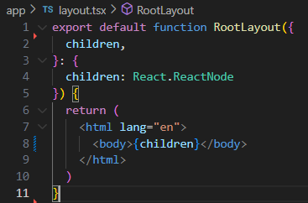

Creating directories
For new applications, using the App Router. This router allows you to use React's latest features and is an evolution of the Pages Router based on community feedback.
Create an app/ folder, then add a layout.tsx and page.tsx file. These will be rendered when the user visits the root of your application (/).

Slide 9
Run the Development Server
Run npm run dev to start the development server.
Visit http://localhost:3000 to view your application.
Edit app/layout.tsx (or pages/index.tsx) file and save it to see the updated result in your browser.

Slide 10
Tailwind CSS

Slide 11
What is Tailwind CSS?
Open-source CSS framework
Includes a huge list of utility CSS classes that can be used to style each element by mixing and matching.
These classes may be about colors, padding, font sizes, etc.
Compared with Bootstrap, Tailwind provides you with the freedom to create custom designs and components easily
https://tailwindui.com/documentation

Slide 12
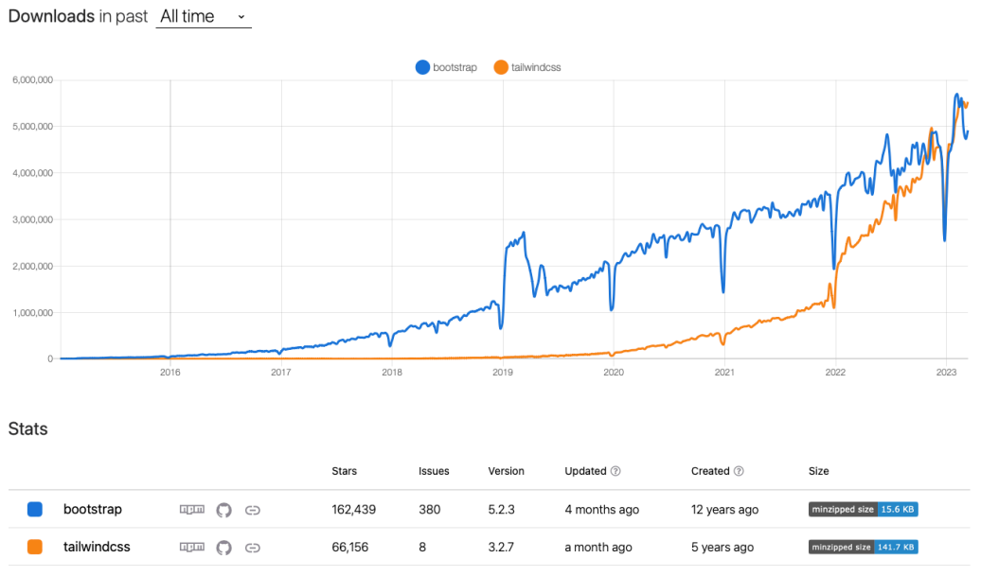
Comparison between Bootstrap and Tailwind CSS
NPM Trends: Bootstrap vs. Tailwind CSS
https://npmtrends.com/bootstrap-vs-tailwindcss

Slide 13
History of Tailwind CSS
Tailwind CSS was created by Adam Wathan and Steve Schoger in 2017.
Wathan, who was a fan of Bootstrap, began adding utility classes such as paddings and flexbox containers.
As more people requested the utility classes, Wathan and Schoger extracted them into a library and eventually open-sourced them.

Slide 14
How To Use Tailwind CSS With React
Install Tailwind CSS:
npm install -D tailwindcss postcss autoprefixer
Generate Configuration Files (tailwind.config.js vs postcss.config.js)
npx tailwindcss init -p
Configure Path To Template Files:
Inside tailwind.config.js
Add Tailwind Directives
Add the following into file index.css:
module.exports = {
content: [
"./src/**/*.{js,jsx,ts,tsx}",
],
theme: {
extend: {},
},
plugins: [],
}
@tailwind base;
@tailwind components;
@tailwind utilities;

Slide 15

How To Use Tailwind CSS With React – cont’d
Use Tailwind CSS In Your React App
Replace the default code in src/App.js with the following implementation:
Start the development web server by using the following command: npm run start
function App() {
return (
<div className="container mx-auto bg-gray-200 rounded-xl shadow border p-8 m-10">
<p className="text-3xl text-gray-700 font-bold mb-5">Welcome!
</p>
<p className="text-gray-500 text-lg">React and Tailwind CSS in action
</p>
</div>
);
}
export default App;

Slide 16
Assignment 02

Slide 17
Summary
Concepts were introduced:
Describe about Next.JS
What is Next.JS?
Installation, Config and Run Next.JS
Describe about tailwind CSS
What is tailwind CSS?
Installation, Config and Run tailwind CSS

